Slide 1
Spring Boot Series – Day 14
Topic: Stateless Authentication with JWT — Eliminating Session-Based Login
@CodeByHaindavi | #SpringWithMe

Slide 2
Why Go Stateless with JWT?
✔️ Session-based login ties authentication to server memory — which breaks in horizontally scaled or containerized environments.
✔️ JWT allows you to authenticate once, issue a signed token, and validate every request independently — no session tracking required.
✔️ Ideal for modern frontend stacks (React, Angular), mobile apps, and any distributed API architecture.
✔️ Improves scalability, eliminates sticky sessions, and reduces server load — making your auth layer truly stateless and cloud-ready.
@CodeByHaindavi | #SpringWithMe

Slide 3
How JWT Authentication Works?
✔️ The client sends login credentials to a secure endpoint like /auth/login.
✔️ If authentication succeeds, the backend generates a signed JWT containing user details, roles, and expiration.
✔️ The client stores this token (usually in localStorage or a secure cookie) and includes it in the Authorization header for future requests.
✔️ Every request is validated purely through the JWT — no sessions, no database calls, no server-side state.
@CodeByHaindavi | #SpringWithMe

Slide 4
Key Differences – Session vs JWT
✔️ Sessions store user state on the server, requiring memory, session IDs, and tracking — not ideal for microservices or scaling.
✔️ JWTs are fully self-contained — signed, stateless, and stored on the client — no server storage or lookup needed.
✔️ Session-based logins fail in distributed environments unless you implement sticky sessions or shared storage.
✔️ JWT-based logins work out of the box across clusters, containers, and edge nodes — making them perfect for stateless architectures.
@CodeByHaindavi | #SpringWithMe

Slide 5
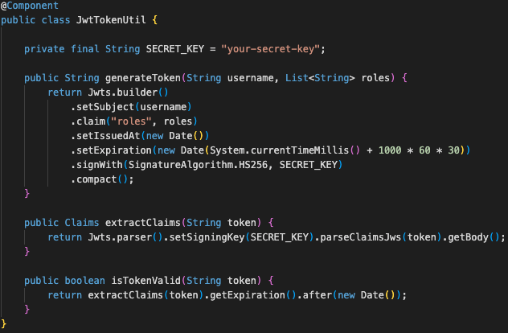
Generating JWT at Login
✔️ Once authentication succeeds, create a JWT containing claims like username, user roles, issued time, and expiration.
✔️ Sign the token using a secure algorithm (e.g. HS256 with a secret key, or RS256 with a private key) to ensure integrity.
✔️ Return the JWT to the client in the login response — typically in the response body or as an HttpOnly cookie.
✔️ Do not store the token on the server — the entire point of JWT is to make authentication stateless.
@CodeByHaindavi | #SpringWithMe

Slide 6
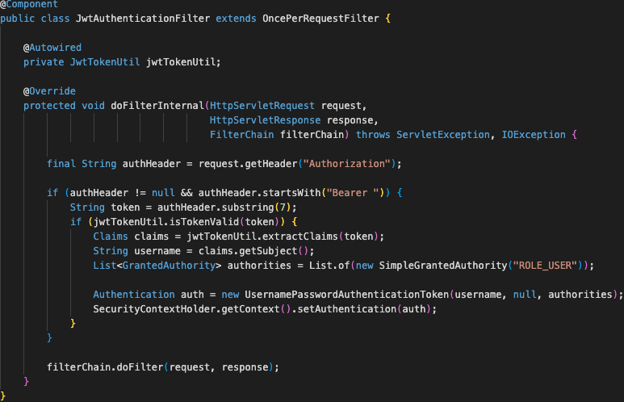
Validating JWT on Each Request
✔️ Create a custom JwtAuthenticationFilter that intercepts every incoming request before Spring Security processes it.
✔️ Extract the token from the Authorization header (using the Bearer <token> format).
✔️ Validate the token's signature, expiration, and claims using a trusted JwtTokenUtil class or library.
✔️ On successful validation, build an Authentication object and inject it into SecurityContextHolder — enabling role-based access control downstream.
@CodeByHaindavi | #SpringWithMe

Slide 7
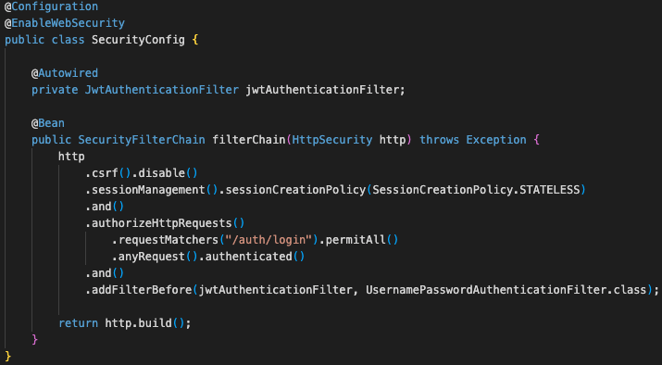
SecurityConfig – JWT Flow
✔️ Disable session creation by setting .sessionCreationPolicy(SessionCreationPolicy.STATELESS) — this is key to making the app truly stateless.
✔️ Register your JwtAuthenticationFilter before UsernamePasswordAuthenticationFilter to ensure JWT validation happens early in the chain.
✔️ Permit /auth/login (or similar login endpoint) for unauthenticated access while securing all other API endpoints.
✔️ Plug in your custom JwtAuthenticationFilter and JwtTokenUtil for token extraction, validation, and user context injection.
@CodeByHaindavi | #SpringWithMe

Slide 8
Stateless Login Flow
✔️ A React (or any frontend) app sends a login request to the backend endpoint /auth/login with user credentials.
✔️ The backend responds with a signed JWT containing user identity, roles, and expiration — no session is created.
✔️ The frontend stores the token securely and attaches it to the Authorization header (Bearer <token>) for every subsequent API call.
✔️ The backend validates the token on each request and authorizes access — fully stateless, scalable, and session-free.
@CodeByHaindavi | #SpringWithMe

Slide 9
📌 Hands-On Tip
✔️ Use a strong secret key (or RSA private key) and keep access token expiry short — 15 to 30 minutes is ideal for security.
✔️ Implement refresh tokens if you need longer sessions without compromising statelessness or reauthentication flow.
✔️ Store JWTs in HttpOnly cookies to reduce exposure to XSS — avoid storing tokens in localStorage if possible.
✔️ Always validate the token’s signature, issuer, audience, and expiration before trusting any claims.
@CodeByHaindavi | #SpringWithMe

Slide 10
💼 Interview Insight
Q1: How would you design token-based stateless authentication that supports logout and token revocation?
• JWTs are stateless and can’t be invalidated server-side by default. • For logout/revocation, introduce a token blacklist using Redis or in-memory store with token IDs or hashes. • Alternatively, issue short-lived access tokens with refresh tokens — and revoke the refresh token upon logout. • Also include a unique jti (JWT ID) in the token for tracking and revocation if needed.
How do you handle token rotation and session extension in a secure, stateless way?
• Use short-lived access tokens (e.g., 15 min) and long-lived refresh tokens (e.g., 7 days) for session extension. • On expiry, the client sends the refresh token to /auth/refresh, and the server issues a new access token. • Rotate refresh tokens after each use to prevent replay attacks and maintain session integrity.
@CodeByHaindavi | #SpringWithMe

Slide 11
📌 Recap – Day 14
🔐 JWT provides fully stateless authentication — no sessions, no server memory, no tracking overhead.
📦 The token itself carries identity, roles, and expiration — verified on every request without any database hit.
🚫 Eliminates sticky sessions and simplifies scaling across containers, clusters, and edge nodes.
🎯 Ideal for modern REST APIs, microservices, SPAs, and mobile clients — secure, decoupled, and scalable by design.
👉 Coming up next: Securing Routes with Roles & Claims — Fine-Grained Access with JWT
@CodeByHaindavi | #SpringWithMe

